Slide 1


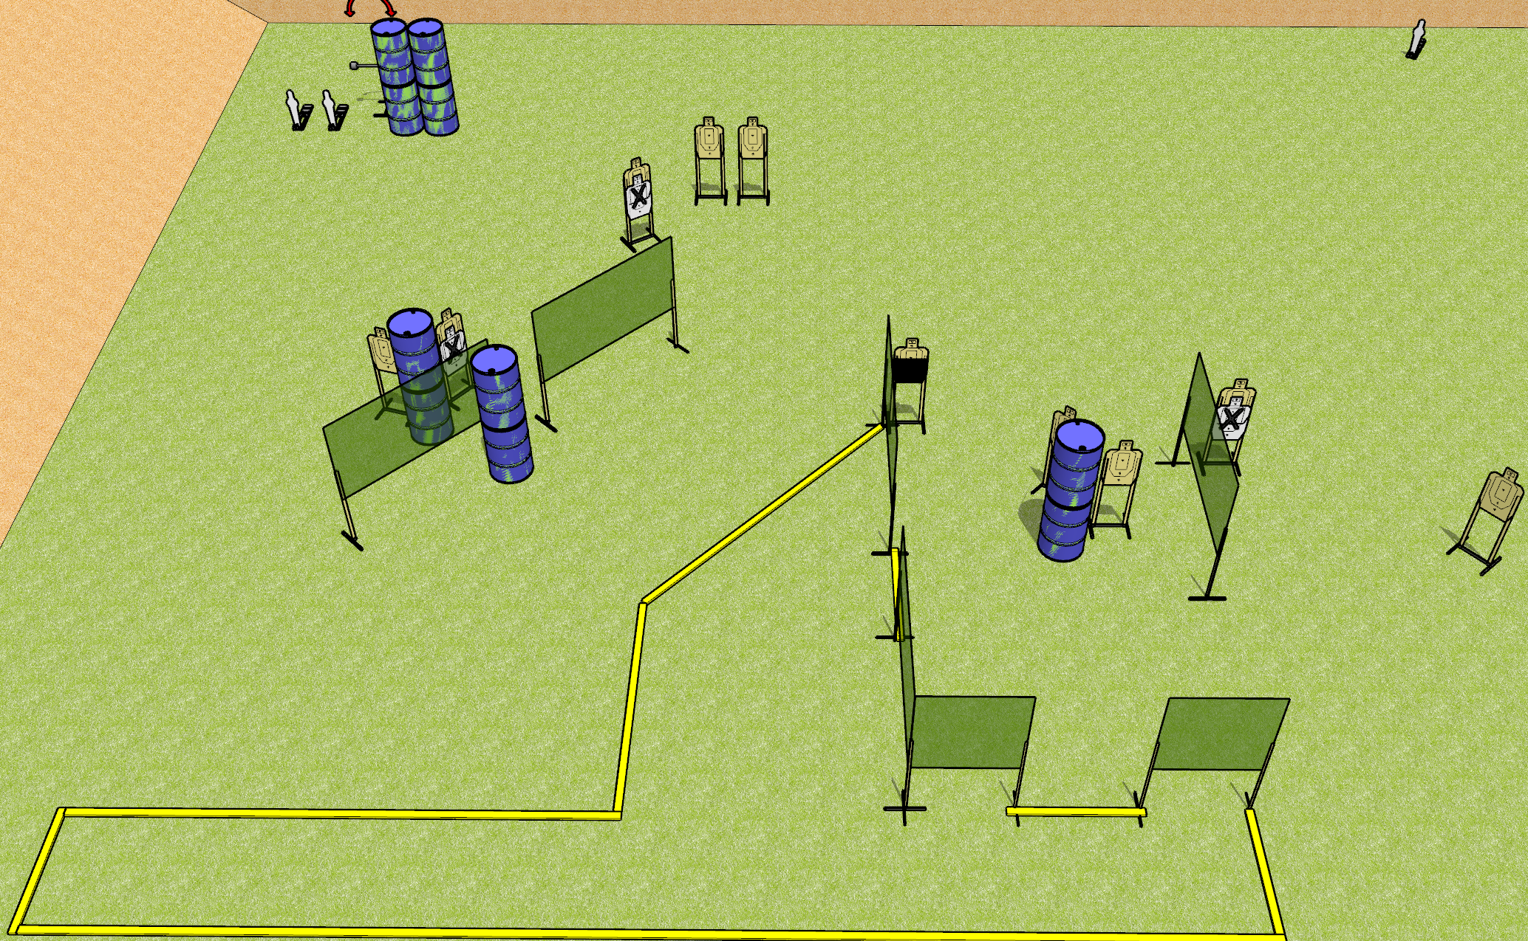
 | Dothan Gun Club – USPSA Match Jackknife Course Designer : Drew Coleman
Round Count 25 rounds 11 USPSA 3 MP
Equipment List 13 wall feet 4 medium fault lines Swinger + activator

Slide 2
Jackknife
Written Stage Briefing
Jackknife is a 25 round, 125 point, Comstock course of fire. There are 11 USPSA targets and 3 steel. The best 2 hits on cardboard will score and steel must fall to score.
The swinger is activated by mini poppers and remains visible at rest.
Handgun start position is anywhere inside the shooting area, wrists below belt. Handgun is loaded and holstered.
PCC start position is anywhere inside the shooting area, stock on belt. Loaded carbine is held with both hands, safety on.
On the audible start signal, engage targets as they become available from within the shooting area.

